Slide 1
Object Oriented Programming Exception Handling
Abeer GAUHER
Email: abeer.gauher@nu.edu.pk
Office: CS BASEMENT 2, Office number 23

Slide 2
Exception Handling
Exception Handling in C++ is a process to handle runtime errors.
We perform exception handling so the normal flow of the application can be maintained even after runtime errors.
In C++, exception is an event or object which is thrown at runtime.
All exceptions are derived from std::exception class.
Advantage
It maintains the normal flow of the application. In such case, rest of the code is executed even after exception

Slide 3
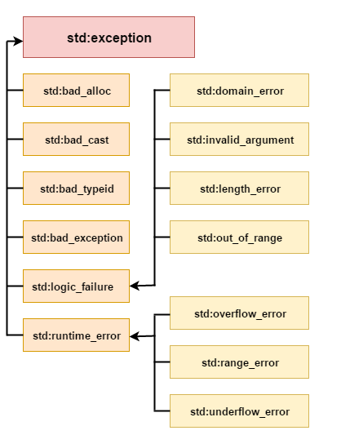
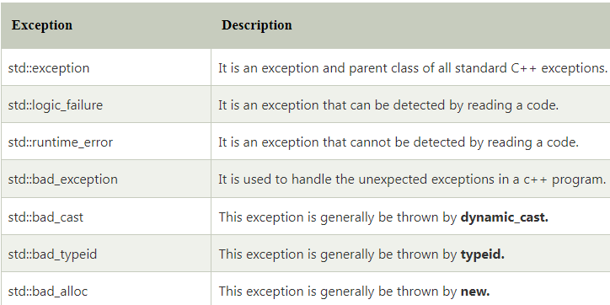
C++ Exception Classes

Slide 4
Exception Handling
C++ Exception Handling Keywords
In C++, we use 3 keywords to perform exception handling:
try
catch, and
throw
Moreover, we can create user-defined exception.

Slide 5
Exception Handling
throw − A program throws an exception when a problem shows up. This is done using a throw keyword.
catch − A program catches an exception with an exception handler at the place in a program where you want to handle the problem. The catch keyword indicates the catching of an exception.
try − A try block identifies a block of code for which particular exceptions will be activated. It's followed by one or more catch blocks.

Slide 6
Exception Handling
SYNTAX
try {
// protected code
} catch( ExceptionName e1 ) {
// catch block
} catch( ExceptionName e2 ) {
// catch block
} catch( ExceptionName eN ) {
// catch block
}

Slide 7
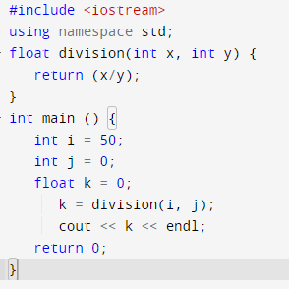
Exception Handling
he C++ try block is used to place the code that may occur exception. The catch block is used to handle the exception.

Slide 8
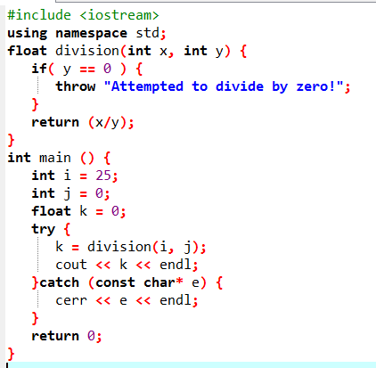
Exception Handling
The C++ try block is used to place the code that may occur exception. The catch block is used to handle the exception.

Slide 9
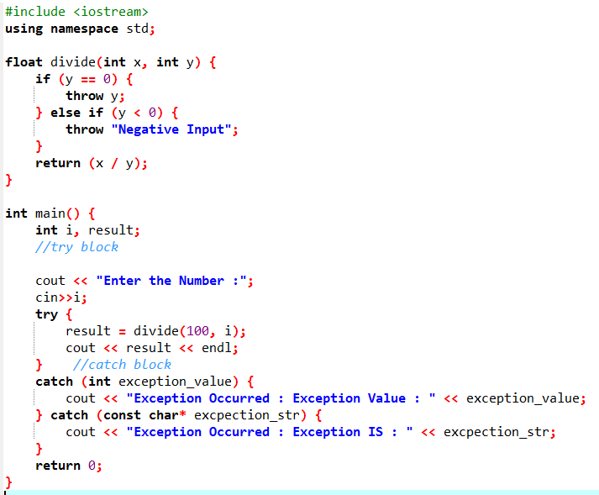

Multiple Catch Block Exception Program In C++
First
Second
Third

Slide 10
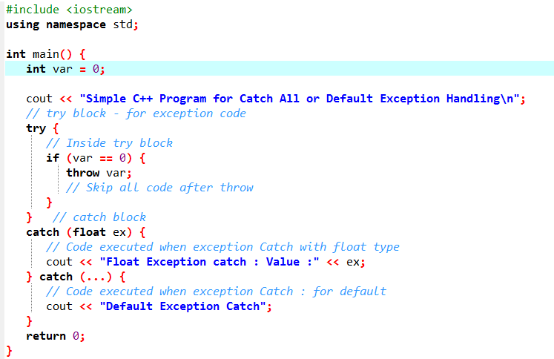
Catch All or Default Exception Handling

Slide 11
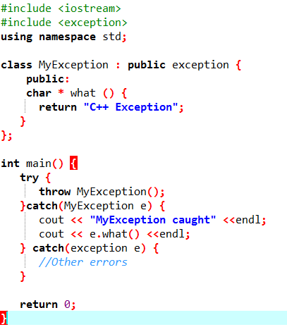

User Defined Exceptions in C++

Slide 12
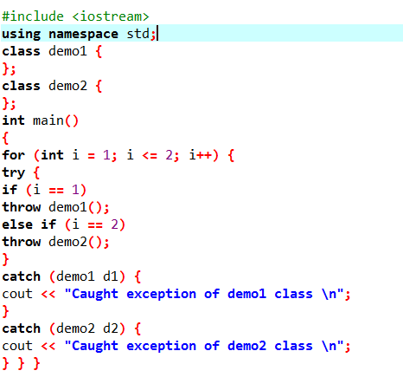

User Defined Exceptions in C++

Slide 13
Task
Write a program that prompts the user to enter a length in feet and inches and outputs the equivalent length in centimeters. If the user enters a negative number or a non - digit number, throw and handle an exception and prompt the user to enter another set of numbers.
Write a program that prompts the user to enter time in 12 hour notation. The program then outputs the time in 24 hour notation. Your program must contain three exception classes: invalidHr, invalidMin and invalidSec. If the user enters an invalid value for hours, then the program should throw and catch an invalidHr object. Do the same for minutes and seconds.

